Slide 1
Software Testing Terminology
Failure:
inability of a system or component to perform a required function according to its specification
when results or behavior of the system under test are different as compared to specified expectations, then failure exists.
Failure is the term which is used to describe the problems in a system on the output side

Slide 2
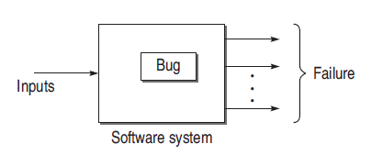
FAULT/DEFECT/BUG
Fault is a condition that causes a system to produce failure
Defect and Bug are synonymous to fault
failures are manifestation of bugs.
Some bugs are hidden

Slide 3

ERROR
Whenever a development team member makes a mistake in any phase of SDLC, errors are produced
It might be a typographical error, a misleading
of a specification, a misunderstanding of what a subroutine does.
Error causes a bug and the bug in turn causes failures

Slide 4
example
Consider the following module in a software:
Module A()
{
….
while(a > n+1);
{
…
print(“The value of x is”, x);
}
….
}

Slide 5
Printing the value of x which is critical for the use of software.
But x is not printed by execution of this module.
This is the failure of the program.
A condition is preventing the body of while loop to be executed.
This is known as bug/defect/fault

Slide 6
TEST CASE
well-documented procedure designed to test the functionality of a feature in the system
It has an identity and is associated with a program behavior
Primary purpose of designing a test case is to find errors in the system.
provide a set of inputs and its corresponding expected outputs to design a test case

Slide 7
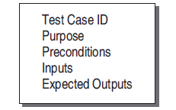
Test case template

Slide 8
Test case ID is the identification number given to each test case.
Purpose defines why the case is being designed.
Preconditions for running the inputs in a system can be defined, if required, in a test case.
Inputs should not be hypothetical. Actual inputs must be provided, instead of general inputs
Expected outputs are the outputs which should be produced when there is no failure.

Slide 9
Testware The documents created during testing activities are known as testware
Incident : An incident is the symptom(s) associated with a failure that alerts the user about the occurrence of a failure
Test oracle An oracle is the means to judge the success or failure of a test, i.e. to judge the correctness of the system for some test

Slide 10
LIFE CYCLE OF A BUG
life cycle of a bug can be classified into two phases:
(i) bugs-in phase and
(ii) bugs-out phase.

Slide 11
Bugs-In Phase
This phase is where the errors and bugs are introduced in the software.
Whenever we commit a mistake, it creates errors on a specific location of the software and consequently, when this error goes unnoticed, it causes some conditions to fail, leading to a bug in the software. This bug is carried out to the subsequent phases of SDLC, if not detected. Thus, a phase may have its own errors as well as bugs received from the previous phase.
If you are not performing verification on earlier phases, then there is no chance of detecting these bugs.

Slide 12
Bugs-Out Phase
If failures occur while testing a software product, we come to the conclusion that it is affected by bugs.
However, there are situations when bugs are present, even though we don’t observe any failures.
In this phase, when we observe failures, the following activities are performed to get rid of the bugs.

Slide 13
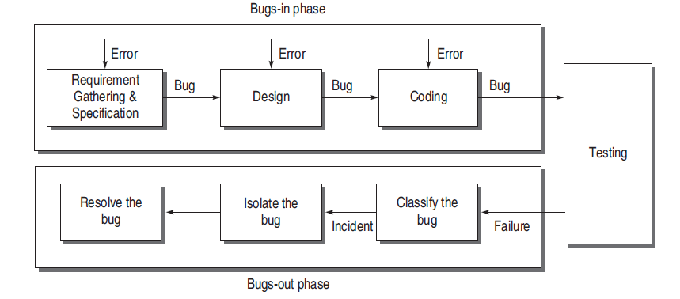
Life Cycle of a Bug

Slide 14
STATES OF A BUG
New The state is new when the bug is reported first time by a tester.
Open The new state does not verify that the bug is genuine. When the test leader approves that the bug is genuine, its state becomes open.
Assign An open bug comes to the development team where the development team verifies its validity. If the bug is valid, a developer is assigned the job to fix it and the state of the bug now is ‘ASSIGN

Slide 15
Deferred The developer who has been assigned to fi x the bug will check its validity and priority. If the priority of the reported bug is not high or there is not sufficient time to test it or the bug does not have any adverse effect on the
software, then the bug is changed to deferred state which implies the bug is expected to be fixed in next releases.
Rejected It may be possible that the developer rejects the bug after checking its validity, as it is not a genuine one.

Slide 16
Test After fixing the valid bug, the developer sends it back to the testing team for next round of checking. Before releasing to the testing team, the developer changes the bug’s state to ‘TEST’. It specifies that the bug has been fixed by the development team but not tested and is released to the testing team.
Verified/fixed The tester tests the software and verifies whether the reported
bug is fixed or not. After verifying, the developer approves that the bug is fixed and changes the status to ‘VERIFIED’

Slide 17
Reopened If the bug is still there even after fi xing it, the tester changes its status to ‘REOPENED’. The bug traverses the life cycle once again.
In another case, a bug which has been closed earlier may be reopened if it appears again. In this case, the status will be REOPENED instead of OPEN.

Slide 18
Closed Once the tester and other team members are confirmed that the bug is completely eliminated, they change its status to ‘CLOSED

Slide 19
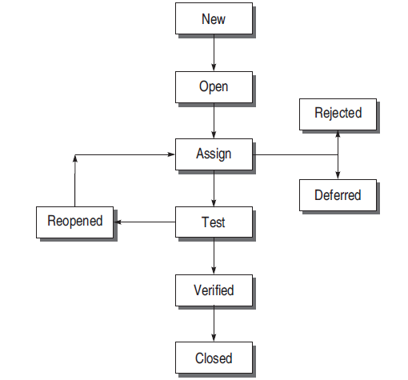
STATES OF A BUG

Slide 20
BUGS AFFECT ECONOMICS OF SOFTWARE TESTING
Testing prior to coding is 50% effective in detecting errors
After coding, it is 80% effective
10 times as costly to correct an error after coding
100 times as costly to correct a production error

Slide 21
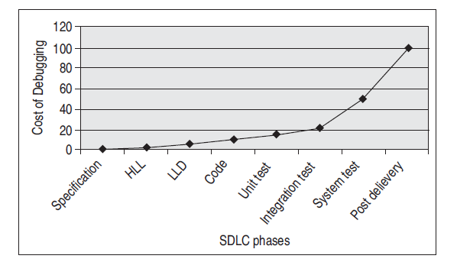
If the bugs embedded in earlier stages go undetected, it is more difficult to detect them in later stages
cost of a bug = Detection Cost + Correction Cost

Slide 22
BUG CLASSIFICATION BASED ON CRITICALITY
Critical Bugs
has the worst effect such that it stops or hangs the normal functioning of the software
Major Bug
does not stop the functioning of the software
It causes a functionality to fail to meet its requirements as expected

Slide 23
Medium Bugs
less critical in nature as compared to critical and major bugs.
outputs are not according to the standards or conventions
Ex : redundant or truncated output
Minor Bugs
do not affect the functionality of the software
occur without any effect on the expected behavior or continuity of the software
Ex: typographical error or misaligned

Slide 24
BUG CLASSIFICATION BASED ON SDLC
Requirements and Specifications Bugs
most of the bugs appear in this phase
If these bugs go undetected, they propagate into subsequent phases
specified requirements may be incomplete, ambiguous, or inconsistent
Specifi cation problems lead to wrong missing, or superfl uous features

Slide 25
Design Bugs
Design bugs may be the bugs from the previous phase
errors which are introduced in the present phase
Control flow bugs - unreachable paths
2. Logic bugs - improper layout of cases, missing cases, improper combination of cases

Slide 26
3. Processing bugs - arithmetic error, incorrect conversion, ignoring overflow, improper use of logical operators
4. Data flow bugs – data flow anomaly errors like un-initialized data, initialized in wrong format, data initialized but not used, data used but not initialized, redefined without any intermediate use
5. Error handling bugs - If the system fails, then there must be an error message or the system should handle the error in an appropriate way

Slide 27
6. Race condition bugs - Race conditions also lead to bugs. Sometimes these bugs are irreproducible
7. Boundary-related bugs - boundaries in loop, time, memory
8. User interface bugs - inappropriate functionality of some features; not doing what the user expects; missing, misleading, or confusing information; wrong content in the help text; inappropriate error messages,

Slide 28
Coding Bugs
undeclared data, undeclared routines, dangling code, typographical errors, documentation bugs

Slide 29
Interface and Integration Bugs
External interface bugs - invalid timing or sequence assumptions related to external signals, misunderstanding external input and output formats, and user interface bugs.
Internal interface bugs - input and output format bugs, inadequate protection against corrupted data, wrong subroutine call sequence, call parameter bugs
Integration bugs - inconsistencies or incompatibilities between modules
Bugs in data transfer and data sharing between the modules.

Slide 30
System Bugs
bugs while testing the system as a whole based on various parameters like performance, stress, compatibility, usability
stress testing is very important
system bugs - system is put under maximum load at every factor like maximum number of users, maximum memory limit, etc. and if it fails

Slide 31
Testing Bugs
Testing is also performed by testers – humans.
failure to notice/report a problem,
failure to use the most
promising test case,
failure to make it clear how to reproduce the problem,
failure to check for unresolved problems just before the release,
failure to verify fixes,
failure to provide summary report

Slide 32
TESTING PRINCIPLES
Effective testing, not exhaustive testing
Testing is not a single phase performed in SDLC
Destructive approach for constructive testing
Early testing is the best policy
Probability of existence of an error in a section of a program is proportional to the number of errors already found in that section

Slide 33
Testing strategy should start at the smallest module level and expand towards the whole program
Testing should also be performed by an independent team
Everything must be recorded in software testing
Invalid inputs and unexpected behavior have a high probability of finding an error
Testers must participate in specifi cation and design reviews

Slide 34
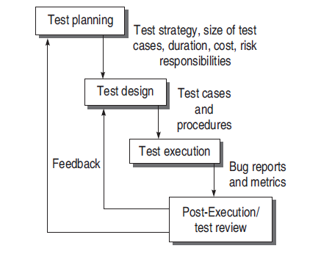
SOFTWARE TESTING LIFE CYCLE (STLC)

Slide 35
Test Planning - Activities
Defining the test strategy.
Estimate the number of test cases, their duration, and cost.
Plan the resources like the manpower to test, tools required, documents required.
Identifying areas of risks.
Defining the test completion criteria.
Identification of methodologies, techniques, and tools for various test cases.
Identifying reporting procedures, bug classification, databases for testing, bug severity levels, and project metrics.

Slide 36
The major output of test planning is the test plan document.
Test plans are developed for each level of testing.
Activities performed:
Develop a test case format.
Develop test case plans according to every phase of SDLC.
Identify test cases to be automated
Prioritize the test cases according to their importance and criticality.
Define areas of stress and performance testing.
Plan the test cycles required for regression testing.

Slide 37
Test Design
It is a well-planned process and important
Activities:
Determining the test objectives and their prioritization
Preparing list of items to be tested
Mapping items to test cases - A matrix can be created

Slide 38
This matrix will help in:
(a) Identifying the major test scenarios.
(b) Identifying and reducing the redundant test cases.
(c) Identifying the absence of a test case for a particular objective and as a result, creating them.
Designing the test cases demands a prior analysis of the program at functional or structural level

Slide 39
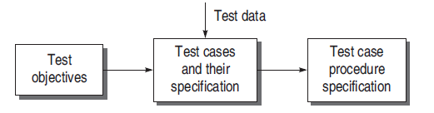
Creating test cases and test data
Setting up the test environment and supporting tools
Creating test procedure specification

Slide 40
Test Execution
Test cases are executed including verification and validation
Opt for automation or manual execution
Test results are documented in the test incident reports, test logs, testing status, and test summary reports

Slide 41
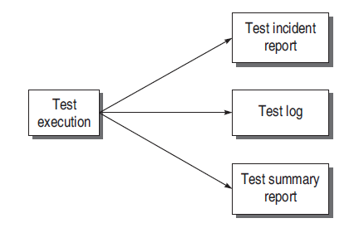
Documents in Test Execution

Slide 42
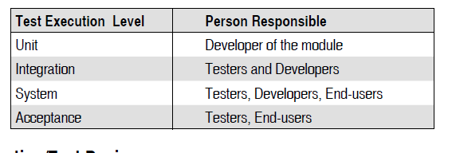
Responsibilities at various levels for execution of the test cases

Slide 43
Post-Execution/Test Review
Analyze bug-related issues and get feedback so that maximum number of bugs can be removed
Activities performed by developer
Understanding the bug The developer analyses the bug reported and builds an understanding of its whereabouts

Slide 44
Reproducing the bug Next, he confirms the bug by reproducing the bug and the failure that exists. This is necessary to cross-check failures. However, some bugs are not reproducible which increases the problems of developers
Analyzing the nature and cause of the bug - A developer starts debugging its symptoms and tracks back to the actual location of the error in the design

Slide 45
After fixing the bug, the developer reports to the testing team and the modified portion of the software is tested once again
Final bug report and associated metrics are reviewed and analyzed for overall testing process.
Activities :
Reliability analysis
Coverage analysis
Overall defect analysis

Slide 46
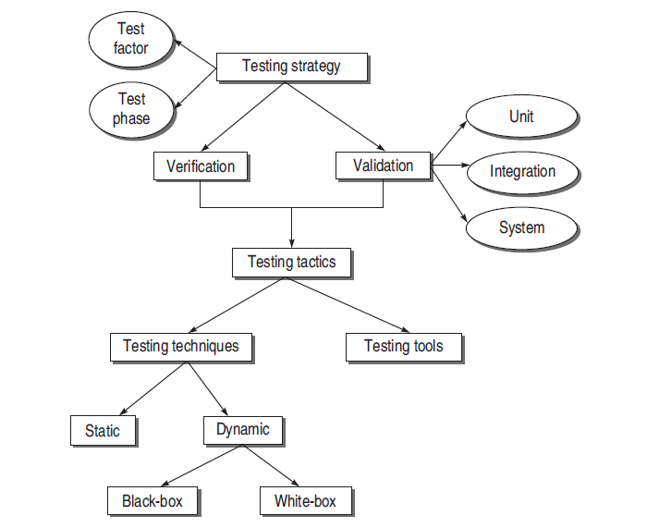
SOFTWARE TESTING METHODOLOGY

Slide 47
SOFTWARE TESTING STRATEGY
Planning of the whole testing process into a well-planned series of steps.
Test Factors
Test factors are risk factors or issues related to the system under development.
Risk factors need to be selected and ranked according to a specific system under development.
The testing process should reduce these test factors to a prescribed level

Slide 48
Test Phase
This is another component on which the testing strategy is based. It refers to the phases of SDLC where testing will be performed.
Testing strategy may be different for different models of SDLC, e.g. strategies will be different for waterfall and spiral models

Slide 49
TEST STRATEGY MATRIX
A test strategy matrix identifies the concerns that will become the focus of test planning and execution.
Steps to prepare this matrix:
Select and rank test factors
Identify system development phases
Identify risks associated with the system under development

Slide 50
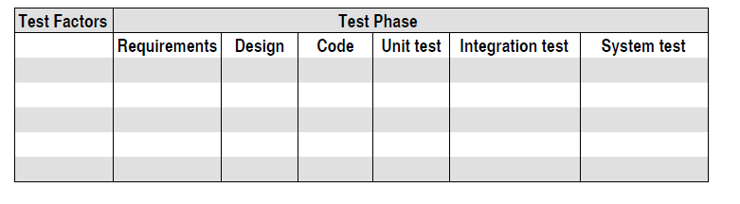
Test strategy matrix

Slide 51
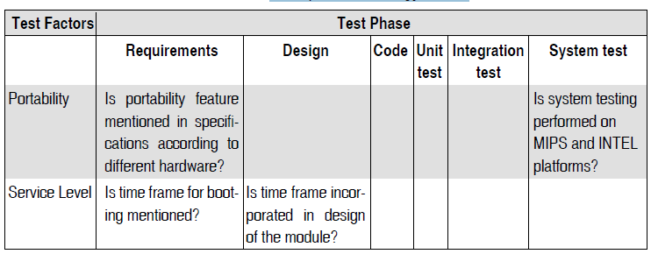
Example test strategy matrix

Slide 52
Suppose a new operating system has to be designed, which needs a test strategy.
Steps used:
Select and rank test factors A critical factor to be considered for the development of an operating system is portability. This is the effort required to transfer a program from one hardware configuration to another. This factor matters the most, as the operating system has to be compatible with most hardware configurations.

Slide 53
Identify the test phases In this step, all test phases affected by the selected test factors are identified.
Identify the risks associated with each test factor and its corresponding test phase All the risks are basic concerns associated with each factor in a phase and are expressed in the form of a question
Plan the test strategy for every risk identified After identifying the risks, it is required to plan a strategy to tackle them. It helps testers to start working on testing so that risks are mitigated

Slide 54
DEVELOPMENT OF TEST STRATEGY
Testing strategy should start at the component level and finish at the integration of the entire system
Verification is ‘Are we building the product right?’
Validation is ‘Are we building the right product?’

Slide 55
TESTING LIFE CYCLE MODEL
Verification and validation (V&V) are the building blocks of a testing process
Life cycle involves continuous testing of the system during the development process
Life cycle testing is dependent upon the completion of predetermined deliverables at a specified point in the development life cycle

Slide 56
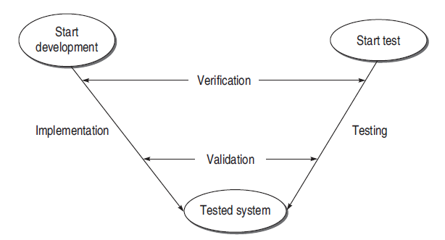
V-Testing Life Cycle Model

Slide 57
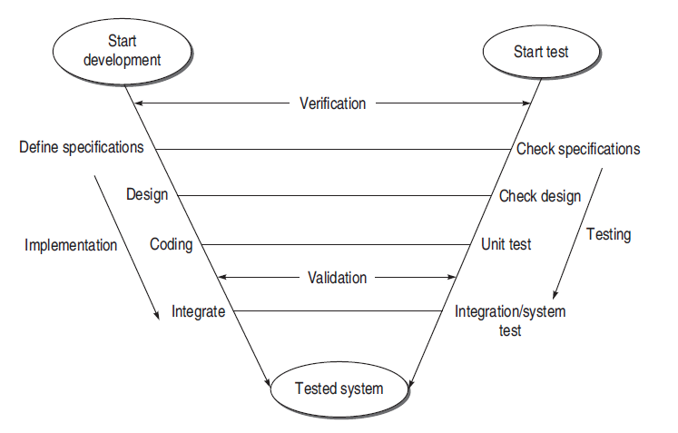
Expanded V-testing model

Slide 58
VALIDATION ACTIVITIES
Three levels of validation testing :
Unit Testing
It is a major validation effort performed on the smallest module of the system.
If avoided, many bugs become latent bugs and are released to the customer.
Unit testing is a basic level of testing which cannot be overlooked, and
Confirms the behavior of a single module according to its functional specifications

Slide 59
Integration Testing
validation technique which combines all unit-tested modules and performs a test on their aggregation
interfacing with other modules remain untested
When one module is combined with another in an integrated environment, interfacing between units must be tested

Slide 60
System Testing
focuses on testing the entire integrated system
It incorporates many types of testing, as the full system can have various users in different environments.
test the validity for specific users and environments.
validity of the whole system is checked against the requirement specifications.

Slide 61
TESTING TACTICS
Software Testing Techniques
Given constraints on time, cost, computer time, etc., the key issue of testing becomes — What subset of all possible test cases has the highest probability of detecting the most errors?

